Slide 1


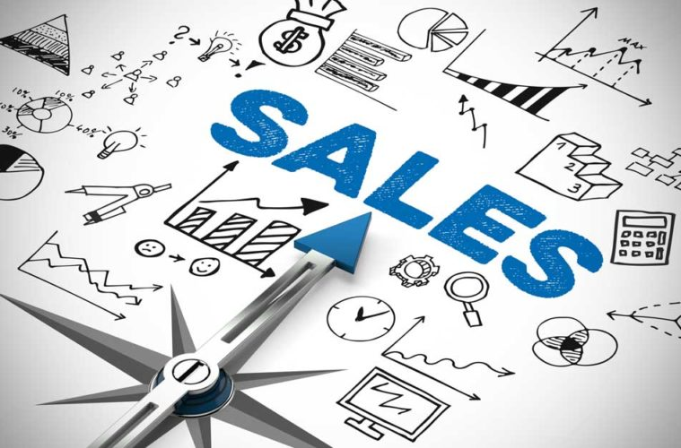
Digital Egypt Pioneers Initiative (DEPI)
«Store Sales Data Analysis»
Under The supervision of :
Instructor: Eng/ Ahmed Samir
Track: Google Data Analyst Specialist CAI2_DAT1_G7
2025/2026

Slide 2
Teamwork
Mohammed Ahmed Abo Elyazzed
Dina Anwar Ragaee Esmail
Nour Eldin Amgad Ezzat Hassan
Mona Abd Elsabour Ahmed

Slide 3
Agenda:
Sales Store Analysis
Chapter2: Data Analysis
Chapter3: Data prediction ( Forecasting)
Chapter1:Data Preparation &Transformation
Chapter4:DataPrescription (Recommendation).

Slide 4
Introduction
Data analysis : It’s the process of systematically inspecting, cleaning, transforming, modeling and Interpreting data to uncover useful information, draw conclusions, and support decision-making. It involves several key steps:
Purpose
Analyze store sales data to uncover actionable insights.
Evaluate product
Category Performance
Understand regional sales distribution
Key Objectives
Analyze shipping delays
Forecast future sales trends

Slide 5




Data Analysis Tools
Chapter1:Data Preparation &Transformation
SQL
Jupyter Notebook libraries
Pandas
NumPy
Seaborn & Matplotlib
rapidfuzz &Plotly
sklearn.preprocessing
Chapter2: Data Analysis
SQL
Jupyter Notebook libraries
Pandas
NumPy
Seaborn & Matplotlib
rapidfuzz & Plotly
sklearn.preprocessing
Tableau for Visualization
Chapter3: Data prediction ( Forecasting)
Jupyter Notebook
Tableau
Chapter4:Data Prescription (Recommendation).
Tableau for
Visualization

Slide 6
Exploratory Data Analysis (EDA)
Data Validity:
1- Constraints
Primary Keys:
-Customer _ id
- Product _ id
-order _ id
-Loc _ id
Composite Primary Keys:
- Product _ id
- order _ id
Foreign Keys:
-Loc _id
-Customer _ id
-order _ id
-Product _ id
2- Data Type
- Row id (int)
- Order date & Ship date(datetime)
-sales (Float)
-( 14 ) Rows ( Object)
Qualitative Data ( Descriptive data) Contains (17) columns
Sales Store Data
(9800 Entries,18 columns)
2015 to 2018
Quantitative Data ( Numerical data) Contains (1) column

Slide 7

Chapter 1: Data Preparation &Transformation:
Data Cleaning of Dataset:
1- Handled by Aggregations & Removed (1) Row Duplicated
2- Mapped product names to unique IDs
Handling Each Product Id has only (1) Product name
And Each product name related to only (1) product id.
To let The primary key unique & Not null
Duplications
Handling Missing Values
(11) Rows are Null in (Postal Code) Column
df['Postal Code'] = df['Postal Code'].fillna(5001)
Manage Inconsistent text formatting
Converted column names to lowercase and replaced spaces with underscores. Converted dates to datetime format
Standardizing Text
df.columns = df.columns.str.strip().str.lower().str.replace(' ', '_')

Slide 8
Chapter 1: Data Preparation &Transformation:
Statistical Analysis of Dataset:
After Using IQR to Check Outliers . Data is Logic &There is no Outliers
IQR=Q3-Q1
Outliers= Q1-1.5*IQR(or)Q3+1.5*IQR
Outliers Detection
Trend Analysis
Monthly Sales Trends:
Peaks in Q4 due to Black Friday’s offers in holiday sales.Lowest sales in Q1.
Product Trends(Yearly Growth):
Technology sales grew from 173K$ (2015) to 269K$ (2018).
Furniture sales peaked in 2018.
Correlations
Positive correlation between # orders & Delayed Orders’ Rate
- The more # orders increased , The more The Duration of Receipt delayed.

Slide 9
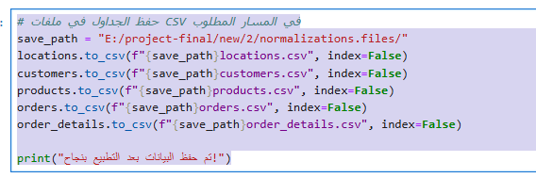
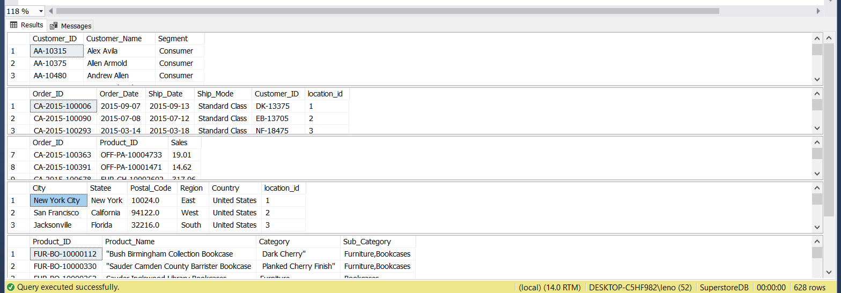
Normalization Step:
Normalization is the process of organizing data in a database to reduce redundancy and improve data integrity.
After Normalization Main Table divided into (5) Areas :
1- Customers
2- Products
3- Orders
4- Order Details
5-Locations

Slide 10
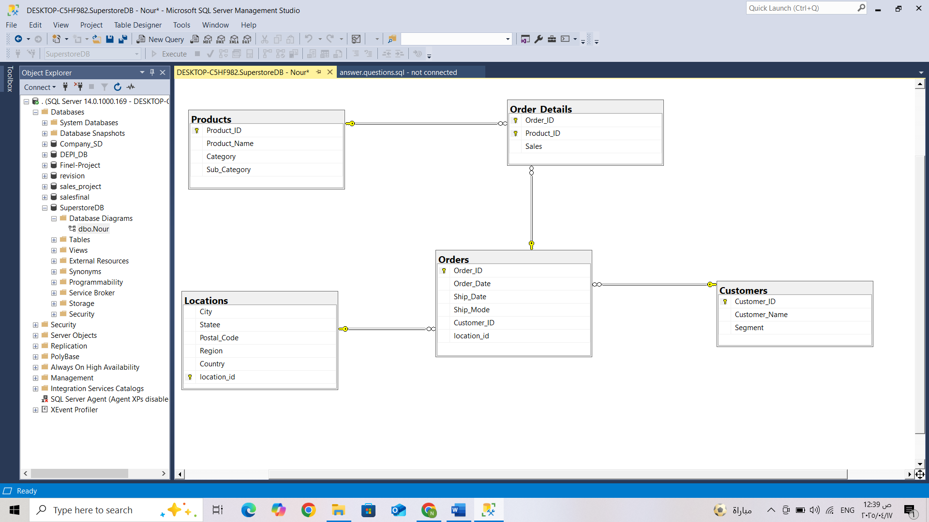
Data Modeling:
Schema

Slide 11
Summary Report
#orders
4922
%OnTime orders
68%
%Delayed orders
32%
Total Sales
2.3M$
#SubCategory
17
#Products
1817
#Category
3
#SubCategory
17
Avg Sales/ order
459$
#Customers
793
#Segment
3
Customer Loyalty Classes
3

Slide 12
Chapter 2: Data Analysis
Data Analysis for “Sales dataset” is conducted on (4) Areas:
Sales
Products
Customers
Geo & Shipping

Slide 13

1st Area
Sales
what is the sales for each category/Subcategory of products?(To get The Highest One for Sales)
What is the achieved sales/ Segment?
Comparison between # orders vs Total Sales/ Region
What is the achieved sales/ State?
Tracking Sales by date.

Slide 14
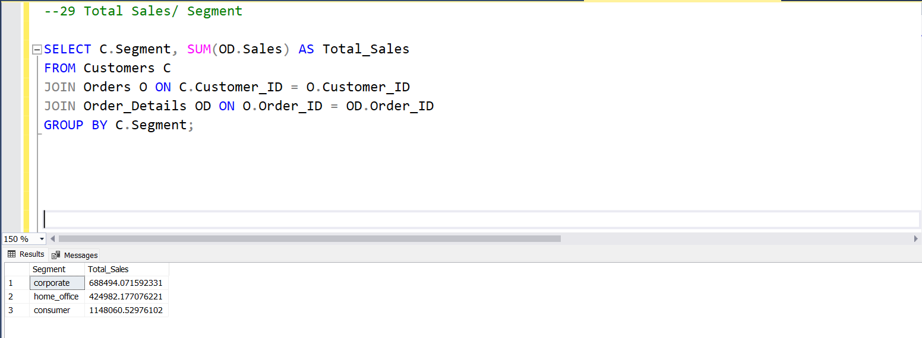
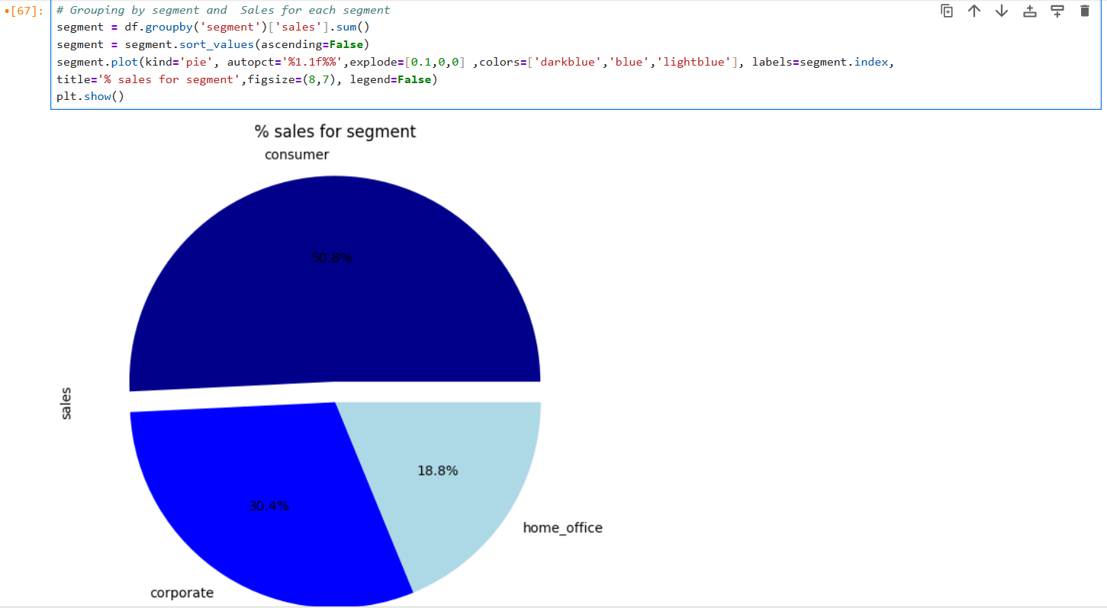
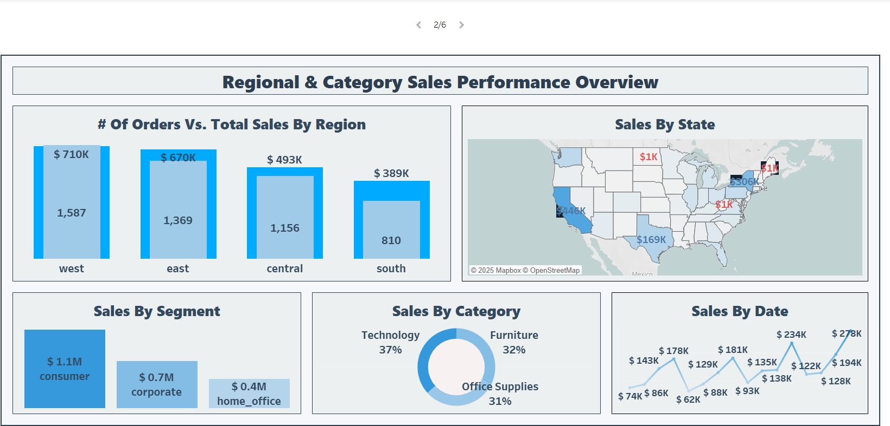
BY SQL:
BY Jupyter:
BY Tableau:

Slide 15
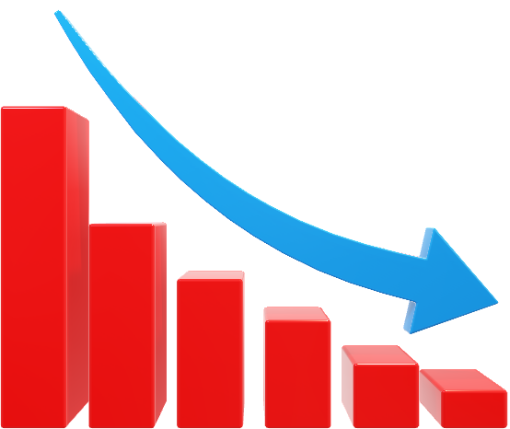
2nd Area
Customers
Create a Classification showing %The Loyalty of Customer through classes (Loyal customer-New customer-Returning customer)
What is the AVG sales/ Customers’ class?
Define %Customer loyalty’s Class in each Segment
Mention # on time orders vs # delayed orders through loyalty’s class
Provide a Comparison between # orders vs Total Sales/ Region

Slide 16
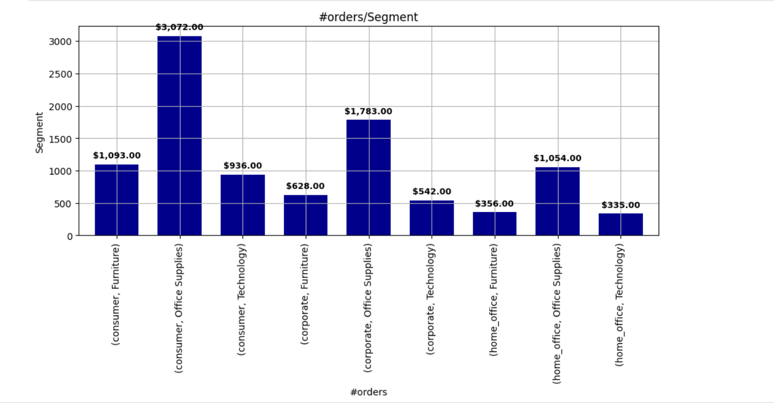
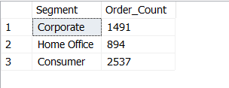
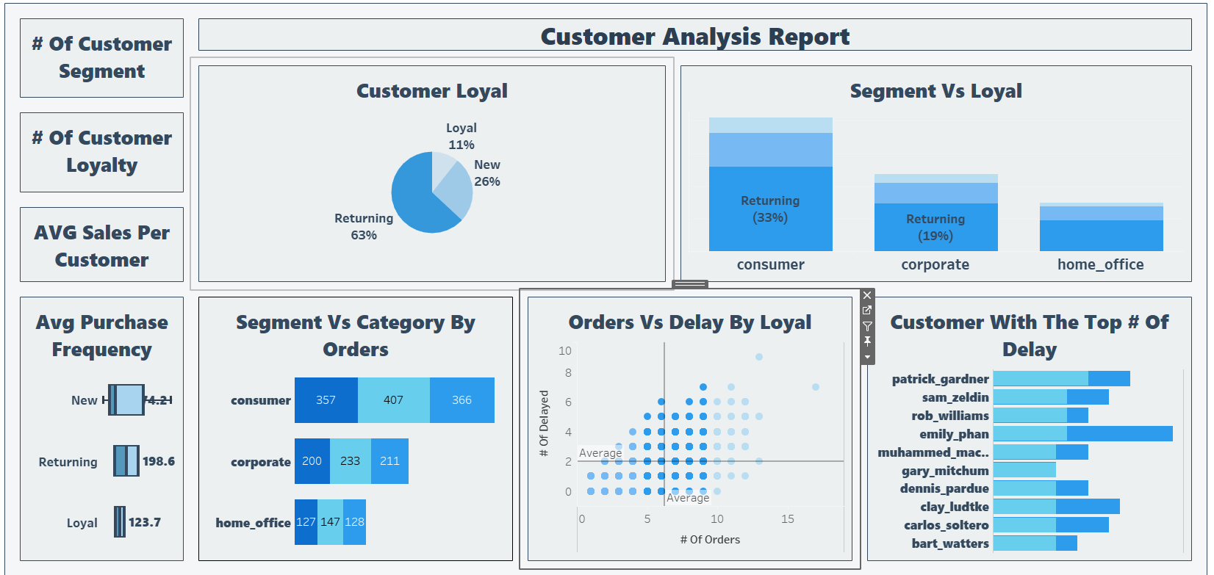
BY Jupyter:
BY SQL:
BY Tableau:

Slide 17
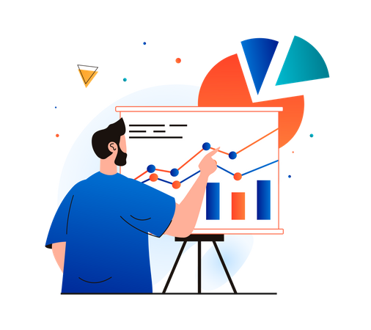
3rd Area
Products
Identify # orders/ category& subcategory of Products.
Mention The Top (10) Products / # orders.
Define % delayed orders/ category.
Mention The Most delayed order/Products.
identify Top Ordered/ subcategory

Slide 18
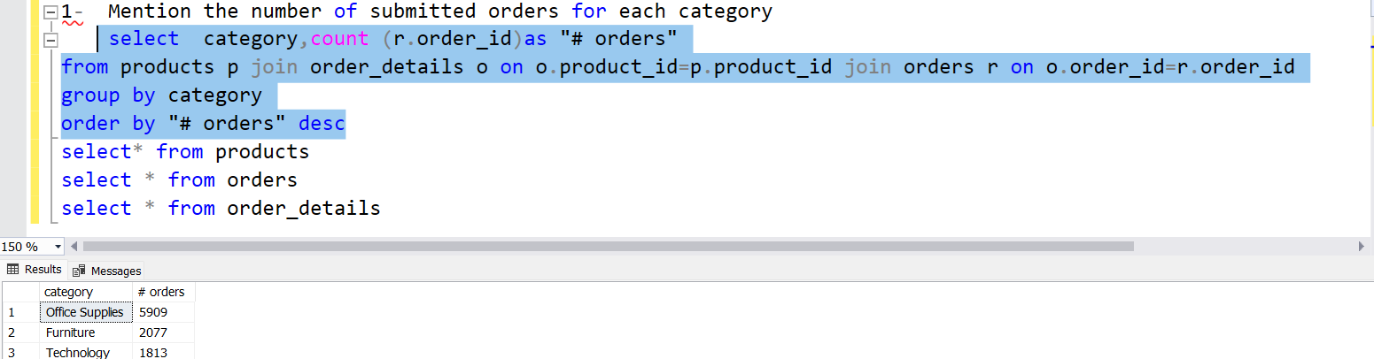
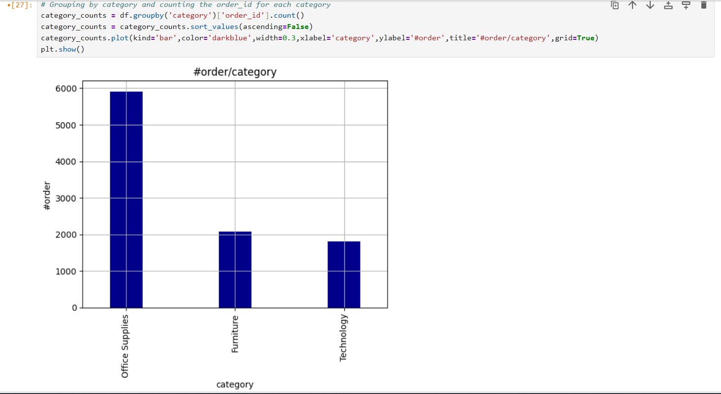
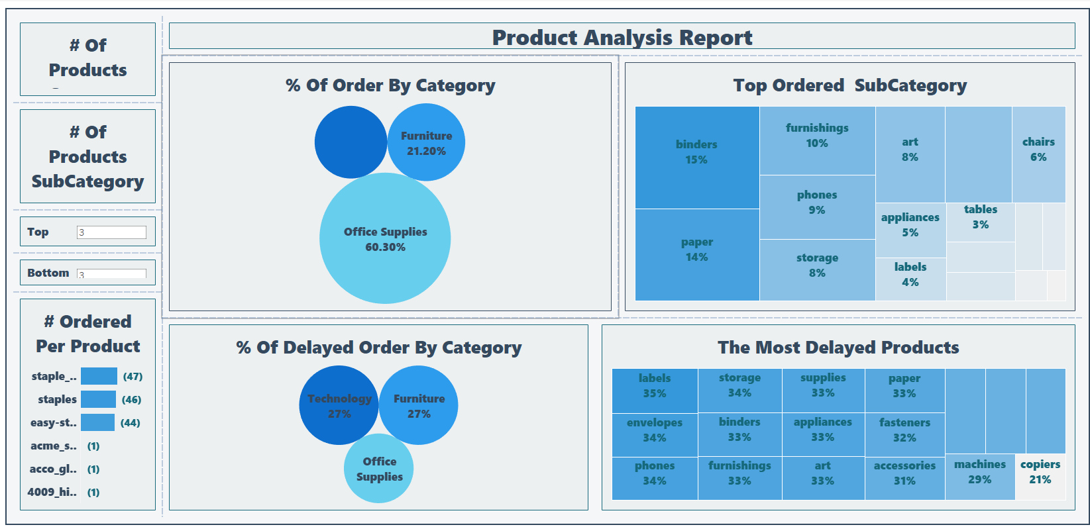
BY SQL:
BY Jupyter:
Technology
%18.50
BY Tableau:

Slide 19

4th Area
Geo & Shipping
Create a Classification of The Duration of Receiving Orders by:( on time orders- Delayed orders) .
Mention The Duration of Receiving Orders/ Ship mode .
Define #orders/ ship mode.
Identify #orders/ states.
Provide a Comparison between # on time orders vs Delayed orders/ship mode.
Track #orders & % Delayed orders in each Month.

Slide 20
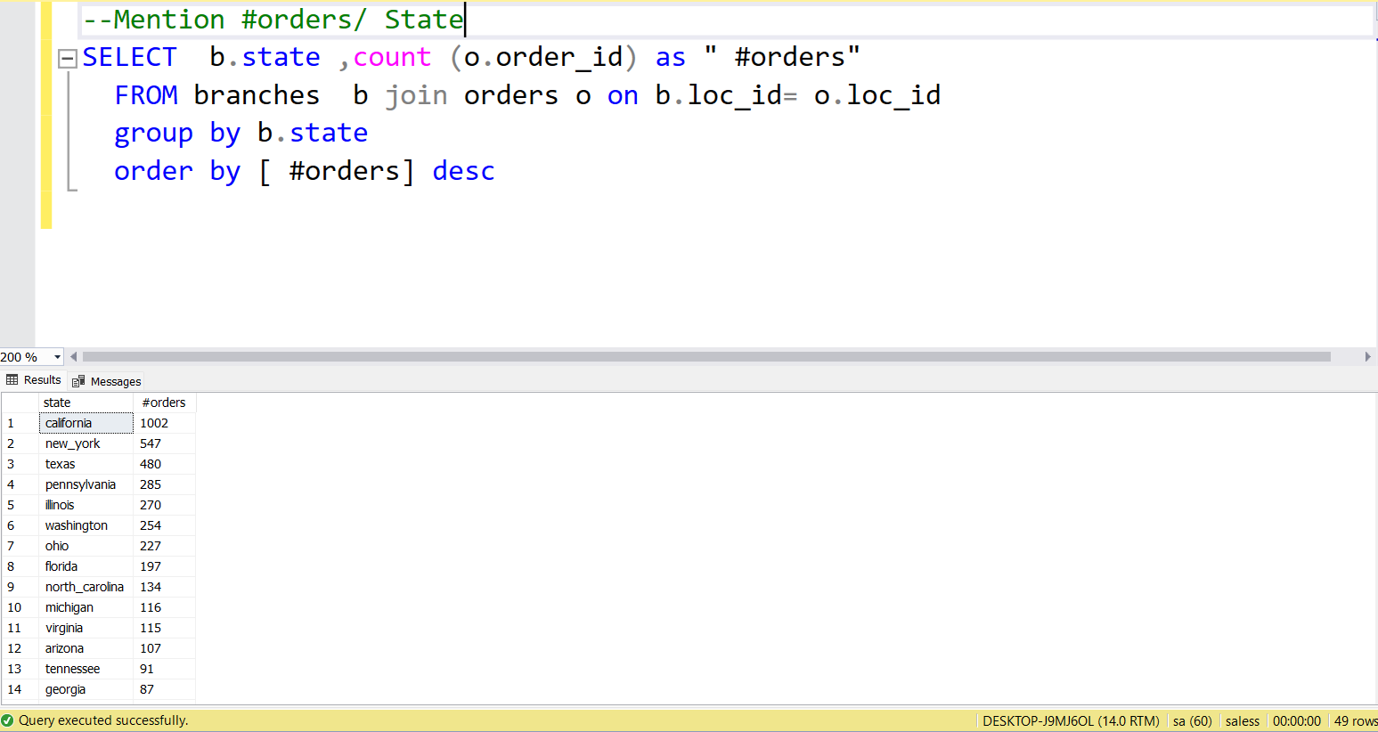
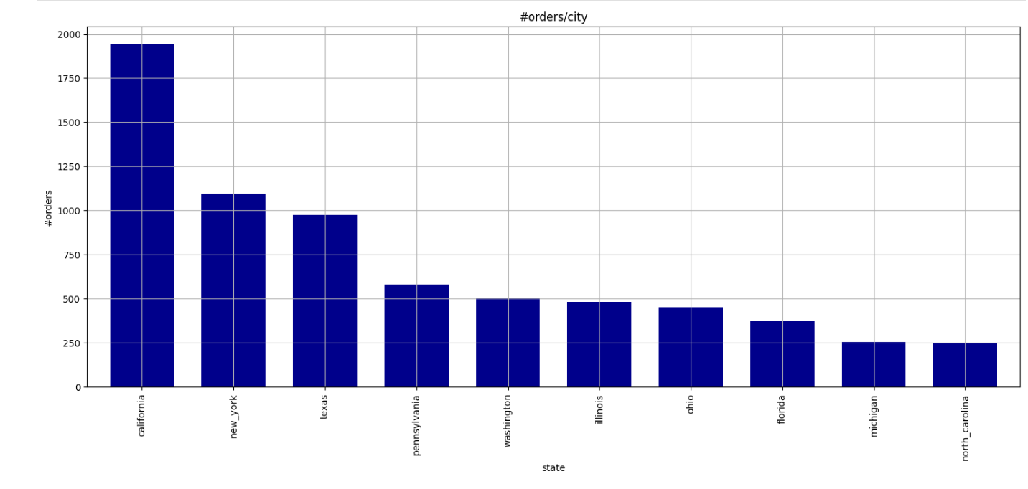
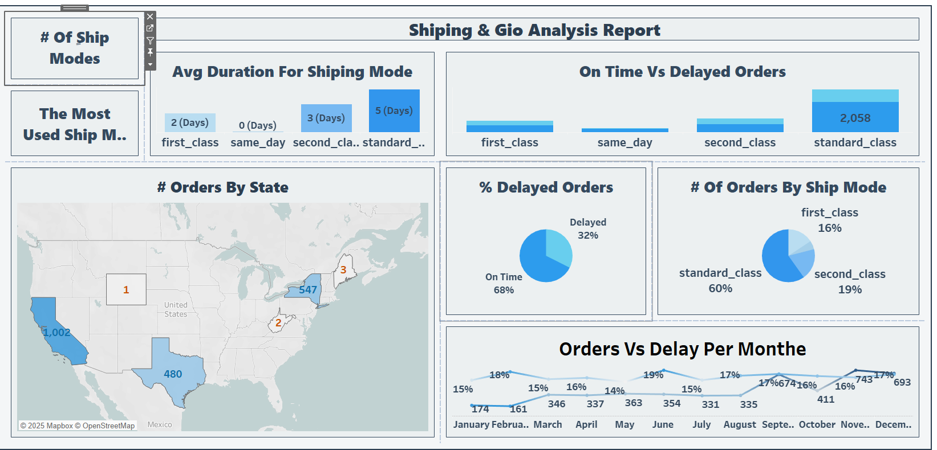
BY SQL:
BY Jupyter:
BY Tableau:

Slide 21
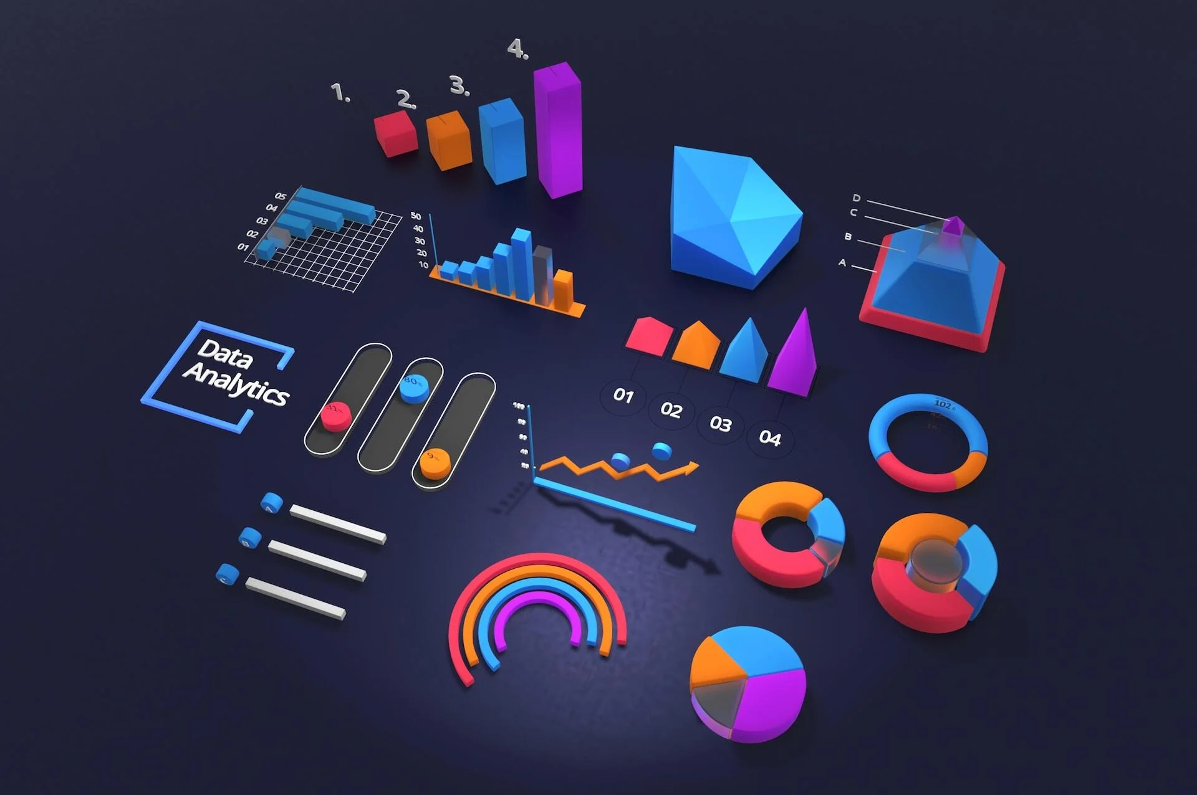
Visualization Step Via Tableau:
Summarized all The Insights of Dataset into (4) Dashboards:
Access Link : For Check The Full Report click here
Key KPIs:
Total Sales
Order Count
Customer Loyalty Segments
Shipping Duration
Sales by Region

Slide 22

Chapter 3: Data Prediction (Forecasting)
Data Prediction
Forecasting
Forecast Highlights
Continued overall sales growth expected
Technology category projected to lead growth
Recommend focusing resources on top regions

Slide 23
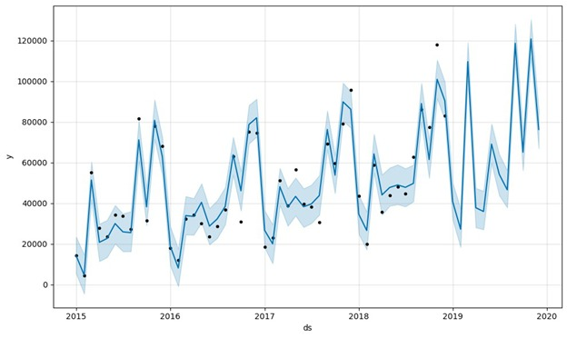
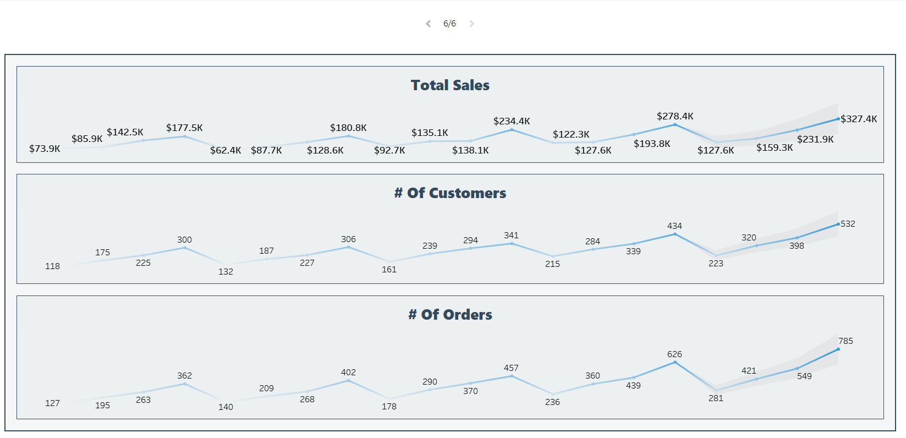
BY Jupyter:
BY Tableau:

Slide 24

Chapter 4: Data Prescription ( Recommendations)

Slide 25


Recommendations for improvement
Customer Experience:
1- Provide Facilities to "new customers " in customer loyalty classification .
2- Develop customer segmentation campaigns .
Inventory:
1- Increase inventory of top-performing products (like Staple Envelope and Binders) to meet demand.
2-Concern The Quality of Top Category " Technology "as it contains The best Selling Products.
3- Handle The Reason for The most delayed products of "labels "with 35%& "storage "with 34% in "Office Supplies".

Slide 26

Recommendations for improvement
Marketing:
1- Optimize operations & Improve Customer services in California .
2- Target South region with promotions expand stores and supervising the Quality Control .
For Geo & Shipping:
1- Improve shipping efficiency .
2- Reducing the duration of Shipping Time to correspond Customer Satisfaction.
3- Encourage loyalty classes specifically in " Same_ day" Ship mode to increase purchase frequency.
4-Monitor June closely to prepare in advance to reduce seasonal delivery issues.
5-Review performance of Technology and Labels categories to identify delay bottlenecks.

Slide 27


